Slide 1
SIT 403
Systems Security and Audit

Slide 2
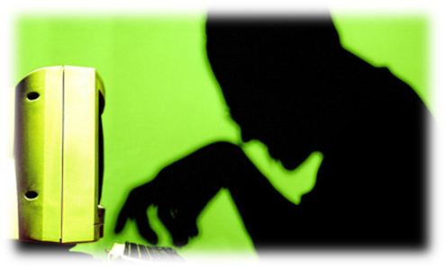
Introduction
Computers and digital devices
are becoming integral to
conducting business
  Which also makes them a target of attack
Devices needs to be secured
Networks that computers and
devices use should also be secured

Slide 3
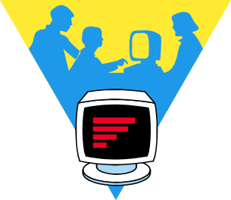
Information Revolution
Information Revolution has taken shape just like the Industrial Revolution
Impact is Political, Economic, and Social as well as Technical
Information has an increasing intrinsic value
Protection of critical information now a critical concern in Government, Business, Academia
95752:1-<number>

Slide 4
Need for Information Security
Confidentiality – restrict access to authorized individuals
Integrity – data has not been altered in an unauthorized manner
Availability – information can be accessed and modified by authorized individuals in an appropriate timeframe
Confidentiality
Integrity
Availability

Slide 5
Security Terms
Exposure - “actual harm or possible harm”
Vulnerability - “weakness that may be exploited”
Attack - “human originated perpetration”
Threat - “potential for exposure”
Control - “preventative measure”
95752:1-<number>

Slide 6
Why is Security Difficult
Managers unaware of value of computing resources
Damage to public image
Legal definitions often vague or non-existent
Legal prosecution is difficult
Many subtle technical issues
95752:1-<number>

Slide 7
Technical System Threats
Hacking: Unauthorized user gaining access to a computer or a network.
Malware: Disrupts computer operations, gathers sensitive information, or gains access to a computer system to compromise data and information.
Spyware Threats – A program that monitors your online activities or installs programs without user’s consent for profit or to capture personal information.
Data interception and theft - Where data is intercepted during transmission. This is done using a software called a packet sniffer, which examines data packets as they are sent around a network, or across the internet.
Denial of service (DOS) - Where a computer is used to prevent a server from performing its tasks. This is done by bombarding the server over and over again with requests. Eventually the server is tied up trying to handle all the DOS requests, making it very difficult for it to respond to legitimate requests.

Slide 8
Non-Technical Vulnerabilities
Physical: Theft, tampering, snooping, sabotage, vandalism, local device access, and assault can lead to a loss of data or information.
Environmental: Natural events such as tornadoes, power loss, fires, and floods pose hazards to the infrastructure in which data assets are located.
Insider Threat: Employees, contractors, or partners can commit fraud, espionage or theft of intellectual property.
Social Media: Employees often fall victim to scams or reveal information not intended for public knowledge on social media.
Dumpster Diving: Improper disposal of sensitive data could lead to improper disclosures and sensitive information just sitting in trash bins. Having internal procedures when disposing of sensitive documents is crucial in preventing this kind of a non-technical vulnerability.
Social Engineering: Attackers rely heavily on human interaction to gain access to company networks or systems, usually tricking users into breaking normal security procedures and revealing their account credentials.

Slide 9
Malware Types
Viruses | Programs embedded (hidden) within other files. They replicate themselves and become part of other programs. Viruses often cause damage by deleting or modifying data.
Worms | Programs similar to viruses except that they are not hidden within other files. Worms often spread through emails.
Trojans | Programs which pretend to be legitimate but in reality are malware. They are often disguised as email attachments. Trojans cannot spread by themselves - instead they deceive a user into installing the program.
Spyware | Programs that monitor user activities (such as websites visited, usernames and passwords used) and send the information back to a hacker.
Ransomware | Programs that attempt to blackmail a user into making a payment to a hacker. Some types of ransomware do little but try to scare users into paying, while others go further - they encrypt documents and will not decrypt them until a ransom is paid.

Slide 10
Data Loss/Breach Prevention
Implement security tools such as firewalls, intrusion detection, and antivirus systems that help to prevent threats.
Use of encryption technologies
Train employees on data security
Develop an information security policy and an incident response plan
Creating BYOD policies
Use of Data Loss Prevention Tools

Slide 11
Data Loss Prevention Tool Features
Cloud support: Supports your cloud and hybrid environments, as well as on-premise assets.
Advanced analytics: The tool should be able to surface insights on data usage, user behavior, and security risks if any.
Data classification: This is one of the foundational features of any data loss prevention tool – automatically scanning huge information stacks to classify data as per the degree of risk/sensitivity.
Integration with your favorite endpoints: The DLP tool must seamlessly integrate with these endpoints, either natively or through APIs.

Slide 12
DLP tools
Arcserve UDP
Barracuda Backup
Code42

